Slide 1
Chapter 2 Operating-System Structures

Slide 2
教学内容、目标与要求
教学内容
操作系统服务
OS用户接口
系统调用
系统程序
OS设计与实现
OS结构
虚拟机
系统启动
教学重点
2、3、6
教学目标与要求
了解操作系统提供的服务；
掌握OS用户接口类型及应用；
掌握系统调用实现机制；
了解如何安装、启动操作系统；
了解OS结构及其特点；
理解虚拟机概念。

Slide 3
Contents
2.1 Operating System Services
2.2 User Operating System Interface
2.3 System Calls
2.4 Types of System Calls
2.5 System Programs
2.6 Operating System Design and Implementation
2.7 Operating System Structure
2.8 Virtual Machines
2.9 Operating System Generation
2.10 System Boot

Slide 4
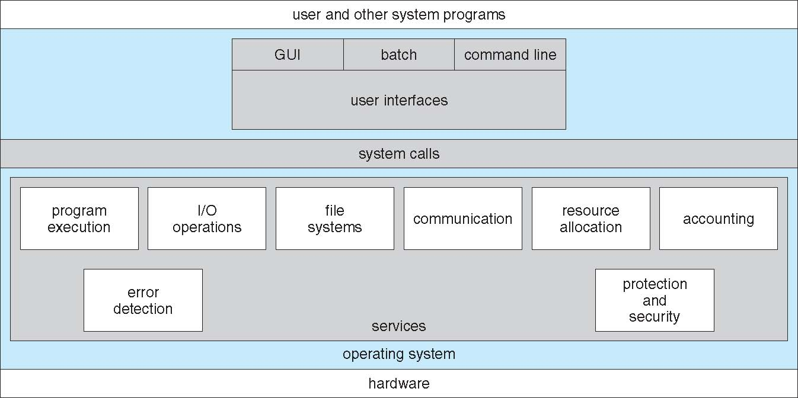
2.1 Operating-System Services
OSs provide an environment for execution of programs and services to programs and users.

Slide 5
Operating-System Services
One set of operating-system services provides functions that are helpful to the user:
User interface (UI)
Command-Line (CLI)
Batch interface
Graphics User Interface (GUI)
Program execution
load a program into memory and to run it
end execution normally or abnormally (indicating error)
I/O operations
access a file on disk, or output to a printer or on screen
File-system manipulation
read and write files and directories, create and delete them, search them, list file information, permission management.
Communications
Processes may exchange information, on the same computer or between computers over a network.
shared memory
message passing
Error detection
Errors may occur in the CPU and memory hardware, in I/O devices, or in user program.
For each type of error, OS should take the appropriate action to ensure correct and consistent computing.
Debugging facilities can greatly enhance the user's and programmer's abilities to efficiently use the system.

Slide 6
Operating-System Services
Another set of OS functions exists for ensuring the efficient operation of the system itself via resource sharing.
Resource allocation
When multiple users or multiple jobs running concurrently, resources must be allocated to each of them.
Many types of resources
Some may have special allocation code, such as CPU cycles, main memory, and file storage.
others may have general request and release code, such as I/O devices.
Accounting
To keep track of which users use how much and what kinds of computer resources.
Protection and security
The owners of information stored in a multiuser or networked computer system may want to control use of that information.
concurrent processes should not interfere with each other.
Protection involves ensuring that all access to system resources is controlled.
Security of the system from outsiders requires user authentication, extends to defending external I/O devices from invalid access attempts.
If a system is to be protected and secure, precautions must be instituted throughout it. A chain is only as strong as its weakest link.

Slide 7
2.2 User Operating-system Interface
Command-Line (CLI) / command interpreter
Graphics User Interface (GUI)

Slide 8
Command Interpreter (CLI)
Command interpreter is the interface between the user and the operating system.
implemented
in kernel (MS-DOS)
by systems program (Windows / UNIX)
shell (UNIX / Linux)
multiple flavors implemented, e.g. Bourne shell, C shell, …
Primarily gets a command from user and executes it.
Commands can be implemented in two ways:
built-in (MS-DOS)
system programs (UNIX)
adding new features doesn’t require to change the interpreter.

Slide 9
Graphical User Interface (GUI)
User-friendly desktop metaphor interface
Usually mouse, keyboard, and monitor
Icons represent files, programs, actions, etc.
Various mouse buttons over objects in the interface cause various actions (provide information, options, execute function, open directory (known as a folder)
Early 1970s, invented at Xerox PARC (帕洛阿尔托研究中心)
Many systems now include both CLI and GUI interfaces
Microsoft Windows is GUI with CLI “command” shell
Apple Mac OS X as “Aqua” GUI interface with UNIX kernel underneath and shells available
Unix and Linux have CLI with optional GUI interfaces, e.g. CDE—Common Desktop Environment KDE—K Desktop Environment GNOME—GNU desktop

Slide 10
Windows的命令控制界面
Windows命令控制界面分两部分
命令解释程序cmd.exe：接受键盘输入的命令
窗口：通过鼠标或键盘进行操作
命令：Dos基本命令＋Windows自有命令
系统信息命令，如time, date, mem
系统操作命令，如shutdown, taskkill
文件系统命令，如copy, del, mkdir
网络通信命令，如ping, netstat, route

Slide 11
命令组合运算
命令的使用
& 命令分隔符
cmd1 & cmd2
&& 若前面的命令成功，则执行后面的命令
cmd1 && cmd2
|| 若前面的命令失败，则执行后面的命令
cmd1 || cmd2
() 命令分组或嵌套
cmd1 || (cmd2 & cmd3)
; 命令参数分隔符
cmd param1;param2
直接在命令行输入命令
运行cmd.exe进入命令行界面
在命令行提示符下输入命令
编制批处理文件
扩展名为.bat或.cmd的文本文件
在命令行提示符下输入批处理文件名
批处理文件可以带有参数
% 1表示第一个参数

Slide 12
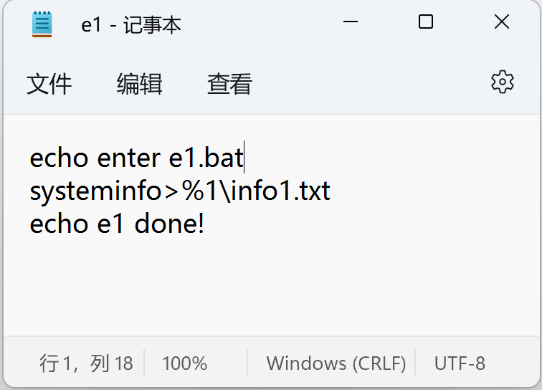
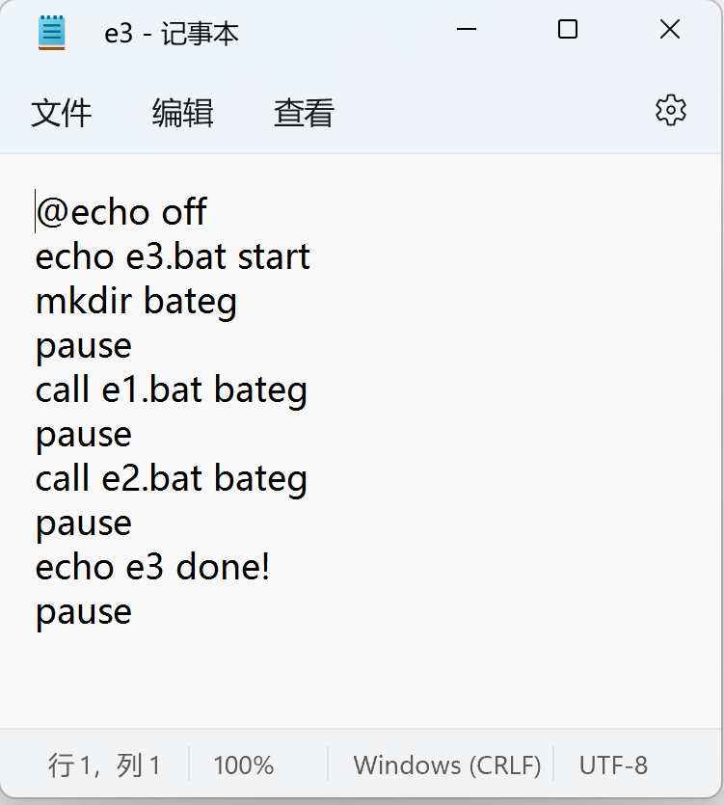
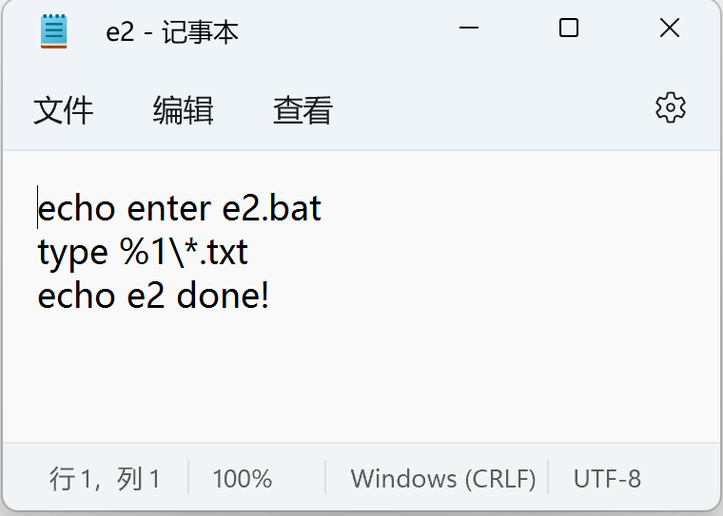
批处理文件示例

Slide 13
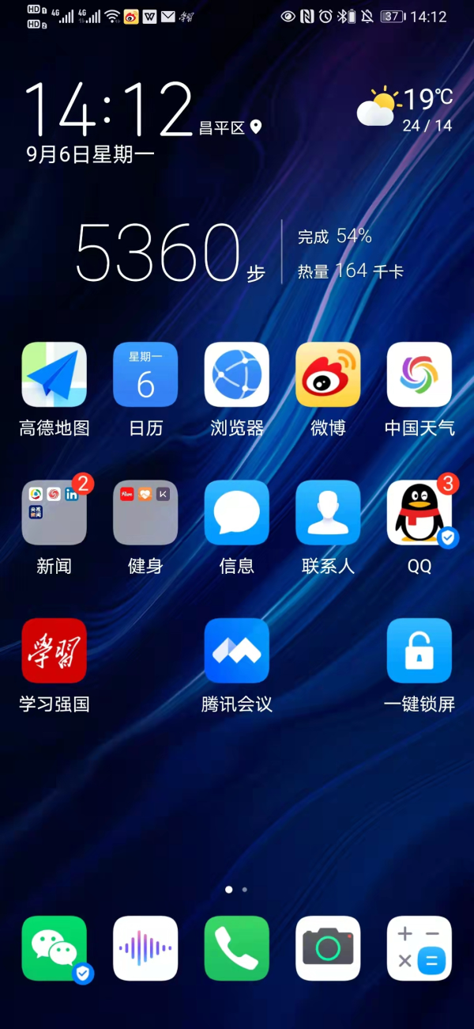
Touchscreen Interfaces
Touchscreen devices require new interfaces
Mouse not possible or not desired
Actions and selection based on gestures
Virtual keyboard for text entry
Voice commands.
A1: 中文UI?
Other UI?

Slide 14
2.3 System Calls
Programming interface to the services provided by the OS.
Example of using system calls: writing a simple program to read data from one file and copy them to another file.
Write a message to the console, input the names of the input file and the output file
Get the names of the input/output files
Open the input file, create the output file
Loop: reads from the input file and writes to the output file.
Close both files
Write a message to the console, terminate normally.

Slide 15
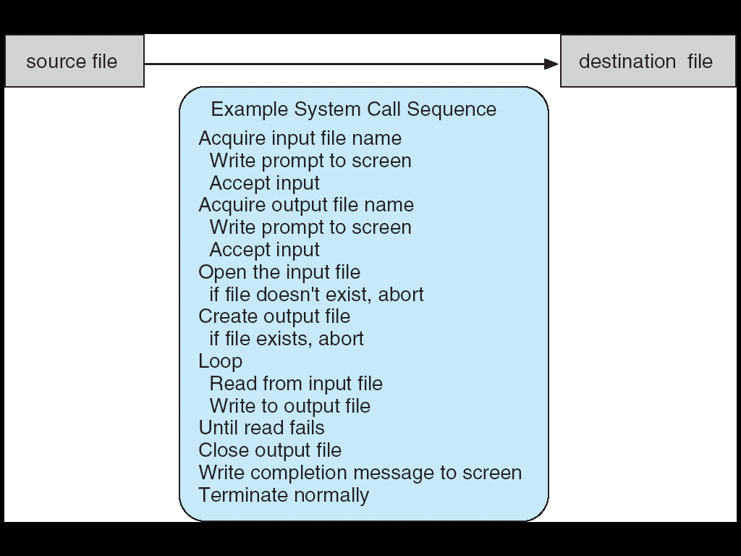
System call sequence to copy the contents of one file to another file
Close input file

Slide 16
System Calls
Typically written in a high-level language (C / C++)
Mostly accessed by programs via a high-level Application Program Interface (API) rather than direct system call use.
The API specifies a set of functions available to an application programmer, including the parameters passed to each function and the return values the programmer can expect.
A programmer accesses an API via a library of code provided by the operating system. (e.g. libc )

Slide 17
System Calls
Three most common APIs:
Windows API, for Windows systems
POSIX API, for POSIX-based systems (including virtually all versions of UNIX, Linux, and Mac OS X)
POSIX：Portable Operating System Interface for computer environment
Java API, for programs that run on the Java virtual machine (JVM)
Why use APIs rather than system calls?
program portability
system calls can often be more detailed and difficult to work with

Slide 18
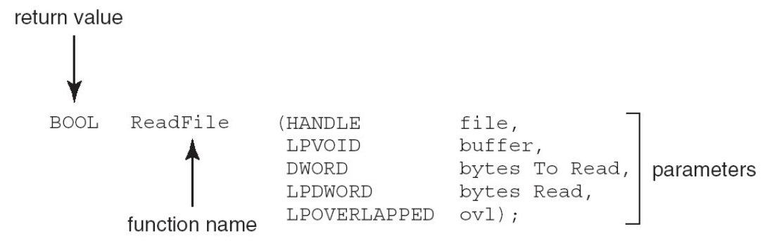
Example of Standard API——in Win32
the ReadFile() function in the Win32 API, a function for reading from a file
parameters：
HANDLE file: the file to be read
LPVOID buffer: a buffer where the data will be read into and written from
DWORD bytesToRead: the number of bytes to be read into the buffer
LPDWORD bytesRead: the number of bytes read during the last read
LPOVERLAPPED ovl: indicates if overlapped I/O is being used

Slide 19
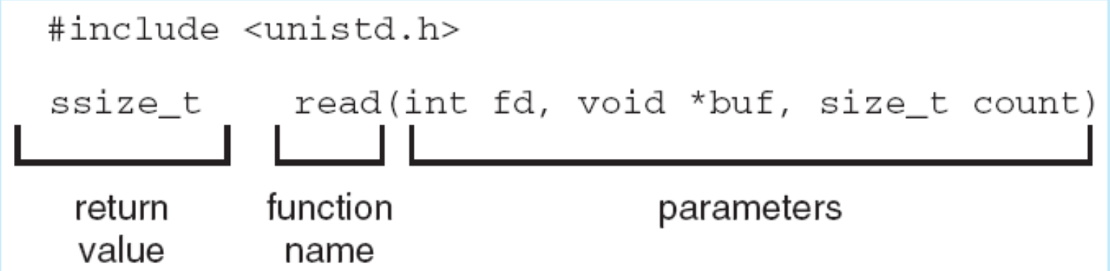
Example of Standard API——in UNIX and Linux
the read() function available in UNIX and Linux systems.
parameters:
int fd: the file descriptor to be read
void *buf: a buffer where the data will be read into
size_t count: the maximum number of bytes to be read into the buffer
return value
a successful read, the number of bytes read is returned.
0 indicates end of file.
-1, error occurs.

Slide 20
System Call Implementation
the run-time support system provides a system-call interface that serves as the link to system calls.
a set of functions built into libraries included with a compiler.
Typically, a number associated with each system call
System-call interface maintains a table indexed according to these numbers.
the system-call interface
intercepts function calls in the API
invokes the necessary system calls within the OS
returns status of the system call and any return values.

Slide 21
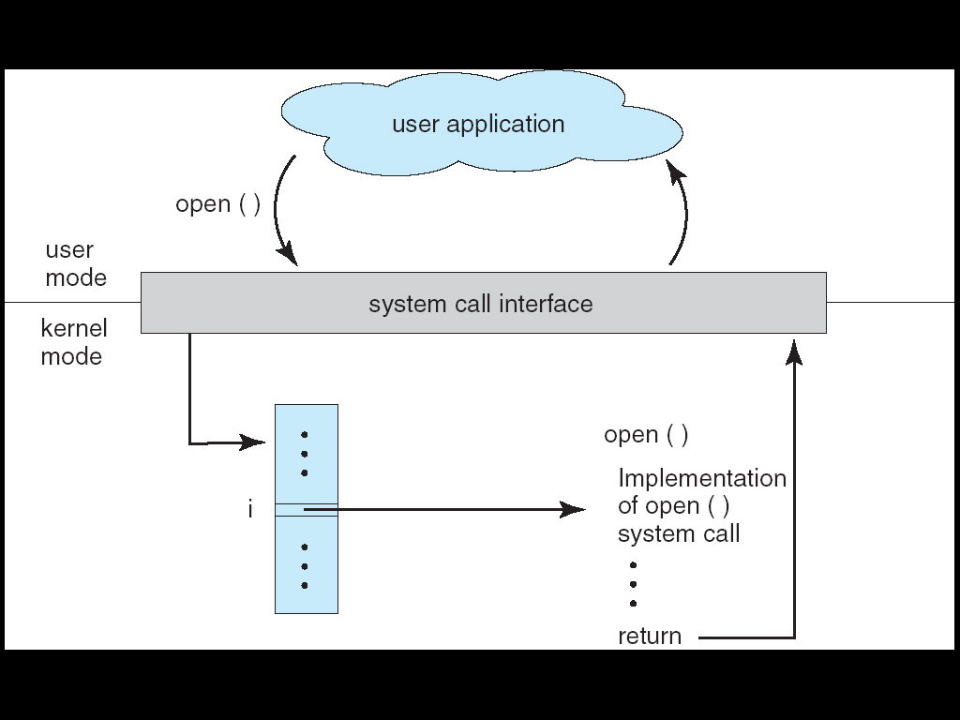
System Call Implementation
The caller need know nothing about how the system call is implemented, or what it does during execution.
needs only obey the API and understand what OS will do as a result.
Most details of OS interface are hidden from programmer by API, and Managed by run-time support library.

Slide 22
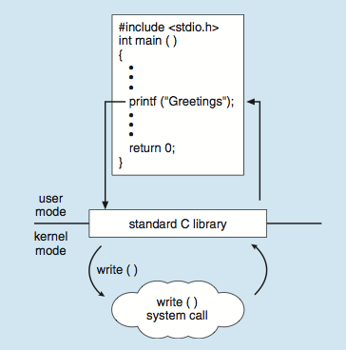
Standard C Library Example
C program invoking printf() library call, which calls write() system call

Slide 23
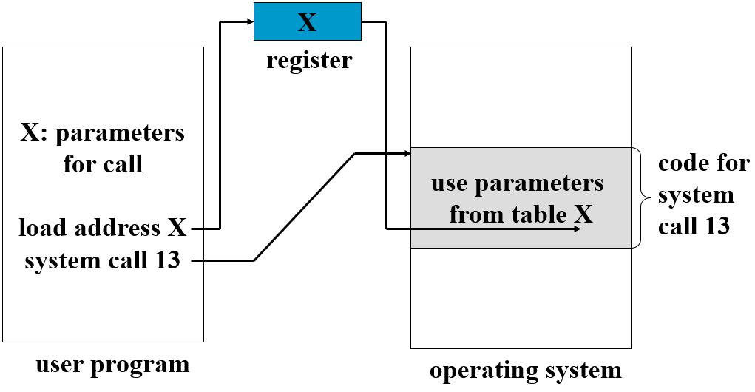
System Call Parameter Passing
Often, more information is required than simply identity of desired system call
Exact type and amount of information vary according to OS and call
Three general methods used to pass parameters to the OS
Registers, Simplest
Memory block, parameters stored in a block, or table, in memory, and address of the block is passed as a parameter in a register (taken by Linux and Solaris)
Stack, Parameters are pushed onto the stack by the program and popped off the stack by the OS
A2: openEuler
系统调用实现

Slide 24
2.4 Types of System Calls
Process control
File management
Device management
Information maintenance
Communications
protection

Slide 25
Process control
end, abort
load, execute
create process, terminate process
get process attributes, set process attributes
wait for time
wait event, signal event
allocate and free memory
Dump memory if error
Debugger for determining bugs, single step execution
Locks for managing access to shared data between processes

Slide 26
File management
Device management
Create file, delete file
open, close
read, write, reposition
get file attributes, set file attributes
Request device, release device
read, write, reposition
get device attributes, set device attributes
logically attach or detach devices

Slide 27
Communications
two common models of communication
message-passing model: information is exchanged through an interprocess-communication facility (IPC) provided by the operating system.
Shared-memory model: process use map memory system call to gain access to regions of memory owned by other processes.
Create, delete communication connection
send, receive messages if message passing model
create and gain access to memory regions if Shared-memory model
transfer status information
attach or detach remote devices

Slide 28
Information maintenance
Protection
Get time or date, set time or date
get system data, set system data
get process, file, or device attributes
set process, file, or device attributes
Control access to resources
Get and set permissions
Allow and deny user access

Slide 29
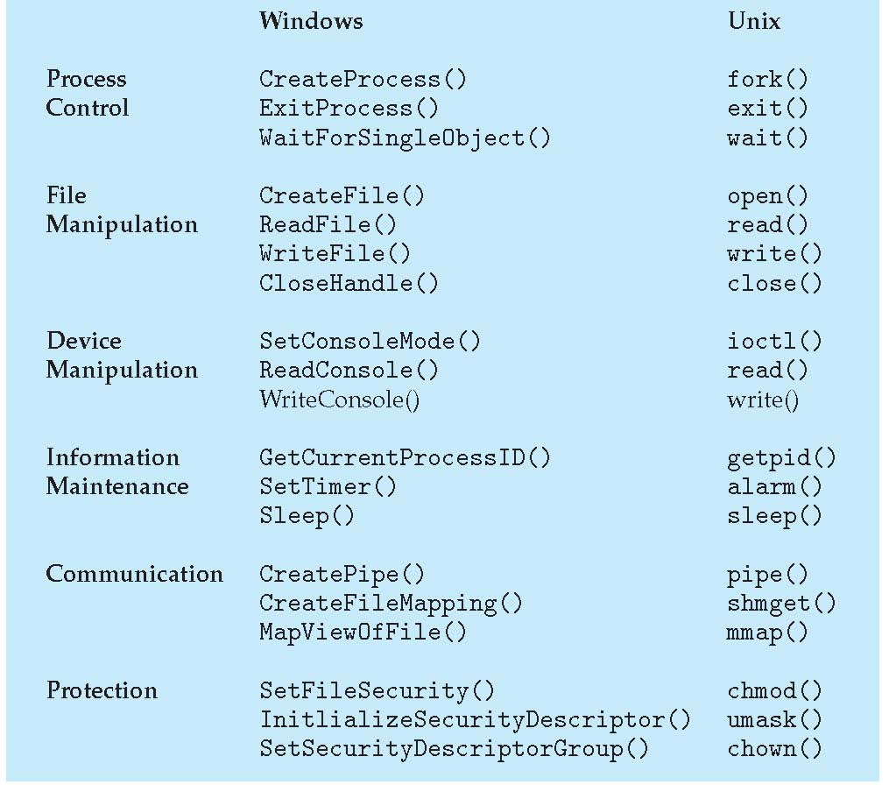
Examples of Windows and Unix System Calls

Slide 30
2.5 System Programs
System programs provide a convenient environment for program development and execution.
Most users’ view of the operation system is defined by system programs, not the actual system calls.
They can be divided into:
File management
Status information
File modification
Programming language support
Program loading and execution
Communications
Background services
System utilities / Application programs

Slide 31
System Programs
File management
Create, delete, copy, rename, print, dump, list, and generally manipulate files and directories.
Status information
Some ask the system for info, such as date, time, amount of available memory, disk space, number of users.
Others provide detailed performance, logging, and debugging information.
Typically, these programs format and print the output to the terminal or other output devices.
Some systems implement a registry, used to store and retrieve configuration information.
File modification
Text editors to create and modify files
Special commands to search contents of files or perform transformations of the text.

Slide 32
System Programs
Programming-language support
Compilers, assemblers, debuggers and interpreters sometimes provided.
Program loading and execution
Absolute loaders, relocatable loaders, linkage editors, and overlay-loaders
debugging systems for higher-level and machine language.
Communications
Provide the mechanism for creating virtual connections among processes, users, and computer systems.
Allow users to send messages to one another’s screens, browse web pages, send electronic-mail messages, log in remotely, transfer files from one machine to another.

Slide 33
System Programs
System utilities / Application programs
Run by users
Not typically considered part of OS
Launched by command line, mouse click, finger poke
Such as Web browsers, word processors and text formatters, spreadsheets, database systems, compilers, plotting and statistical-analysis packages, and games.
Background Services
Launch at boot time
Some for system startup, then terminate
Some from system boot to shutdown
Provide facilities like disk checking, process scheduling, error logging, printing
Run in user context not kernel context
Known as services, subsystems, daemons

Slide 34
2.6 OS Design and Implementation
Design and Implementation of OS not “solvable”, but some approaches have proven successful.
Internal structure of different Operating Systems can vary widely.
Start by defining goals and specifications.
Affected by choice of hardware, type of system (batch, time-shared, real-time, single or multiuser, distributed)
Hard to specify the requirements.
User goals: convenient to use, easy to learn and to use, reliable, safe, and fast.
System goals: easy to design, implement, and maintain, as well as flexible, reliable, error-free, and efficient.

Slide 35
OS Design and Implementation
Specifying and designing an OS is highly creative task of software engineering.
Important principle: separate Policy from Mechanism
Policy: What will be done?
Mechanism: How to do it?
The separation of policy from mechanism is a very important principle, it allows maximum flexibility if policy decisions are to be changed later.
Setting of the length of time slice
Giving priority to certain types of programs
Example
Unix. scheduling, depends on the table currently loaded.
Windows. mechanism and policy are encoded in the system, All applications have similar interfaces

Slide 36
Implementation
Much variation
Early OSes in assembly language.
Then system programming languages like Algol, PL/1
Now C, C++.
Actually usually a mix of languages
Lowest levels in assembly
Main body in C
Systems programs in C, C++, scripting languages like PERL, Python, shell scripts
More high-level language
easier to port to other hardware
but slower, increase storage requirements
Emulation can allow an OS to run on non-native hardware.

Slide 37
Implementation
major performance improvements in OS:
better data structures
algorithms
only a small amount of the code is critical to high performance:
the interrupt handler, I/O manager
memory manager, CPU scheduler
After written and working correctly, bottleneck routines can be identified.
replaced with assembly-language equivalents.

Slide 38
2.7 Operating-System Structure
General-purpose OS is a very large and complex program
partition the task into small components, or modules
a well-defined portion of the system, with carefully defined inputs, outputs, and functions.
interconnected and melded into a kernel.
Various ways to structure the OS
simple Structure
MS-DOS
UNIX
Layered Approach
Microkernels
Modules

Slide 39
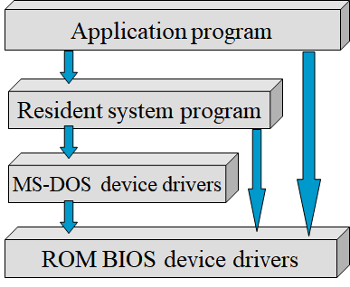
Simple structure: MS-DOS
MS-DOS – written to provide the most functionality in the least space
not divided into modules carefully.
Although MS-DOS has some structure, its interfaces and levels of functionality are not well separated.
limited by the hardware, the Intel 8088 provides
no dual mode
no hardware protection

Slide 40
Simple Structure: original UNIX
original UNIX had limited structuring, limited by hardware functionality.
(the user)
shells and commands
compilers and interpreters
system libraries
system-call interface to the kernel
signals terminal
handling
character I/O system
terminal drivers
file system
swapping block I/O
system
Disk and tape drivers
CPU scheduling
page replacement
demand paging
virtual memory
kernel interface to the hardware
terminal controllers
terminals
device controllers
disks and tapes
memory controllers
physical memory

Slide 41
original UNIX
consists of two separable parts:
System programs
The kernel
separated into a series of interfaces and device drivers.
Consists of everything below the system-call interface and above the physical hardware.
Provides the file system, CPU scheduling, memory management, and other operating-system functions.
a large number of functions for one level.
System calls define the API to UNIX.
The set of system programs commonly available defines the user interface.

Slide 42
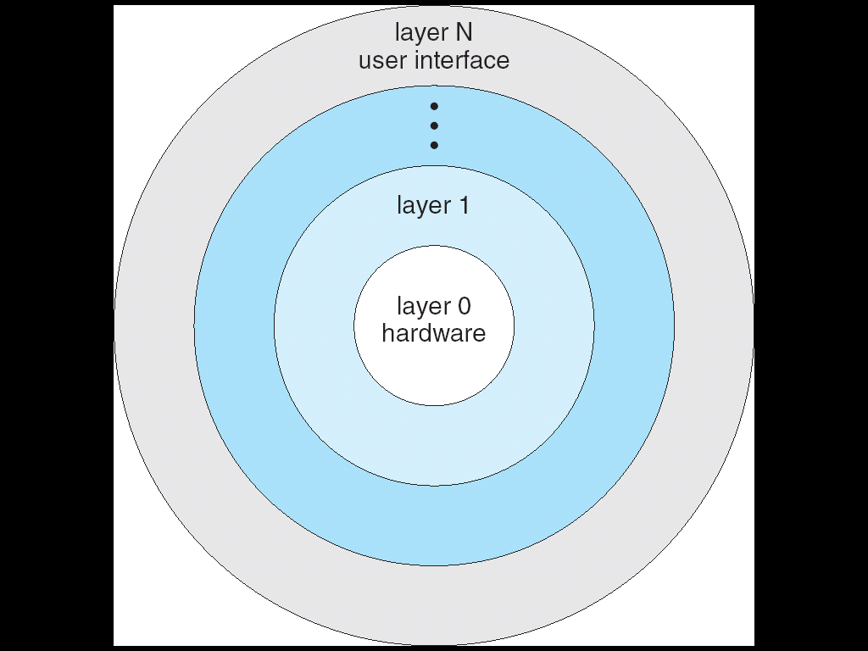
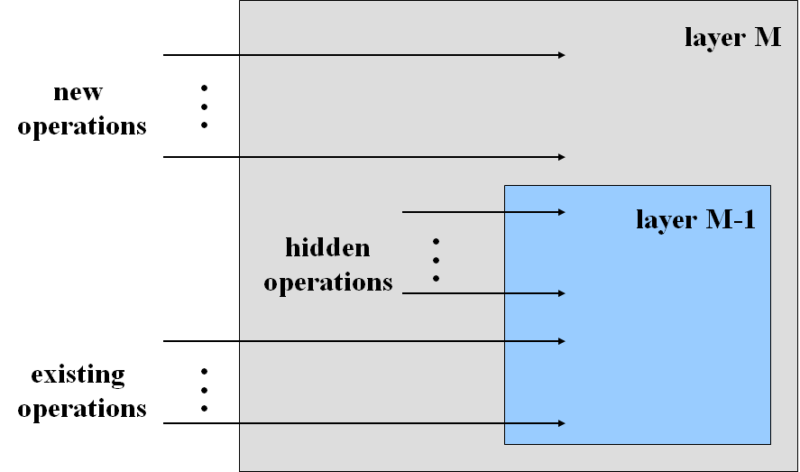
Layered Approach
The OS is broken up into a number of layers (levels),
each built on top of lower layers
the bottom (0th) layer is the hardware
the highest (N^{th}) layer is the user interface
An OS layer is an implementation of an abstract object made up of data and the operations that can manipulate those data.
With modularity, layers are selected such that each uses functions (/ operations) and services of only lower-level layers.

Slide 43
Layered System Structure
View the system as a series of levels.
Each level performs a related subset of functions.
Each level relies on the next lower level to perform more primitive functions.
This decomposes a problem into a number of more manageable subproblems.
main advantage
Simplicity of construction and debugging.
Simplified the design and implementation of the system.
major difficulty: careful definition of the layers.
The disk driver and the memory-management routines
disk space used by virtual-memory algorithms
memory management requires the ability to use the backing store

Slide 44
Layered System Structure
major difficulty: careful definition of the layers.
The disk driver and the CPU scheduler
The disk driver normally is above the CPU scheduler. The driver may need to wait for I/O and the CPU can be rescheduled during this time.
The disk driver is below the CPU scheduler. On a large system, the CPU scheduler may have more information about all the active processes than can fit in memory, this information may need to be swapped in and out of memory, requiring the disk driver routine to be below the CPU scheduler.

Slide 45
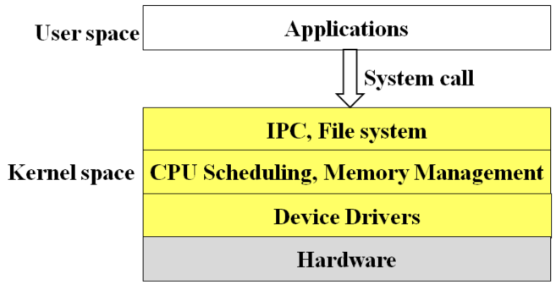
Layered System Structure
less efficient than other types.
E.g. executes an I/O operation.
executes a system call, trapped to the I/O layer
calls the memory-management layer
calls the CPU-scheduling layer
passed to the hardware.
At each layer, the parameters may be modified, data may need to be passed, and so on.
Each layer adds overhead to the system call.
Macro kernel
Monolithic kernel
The whole core program runs as kernel space and supervisor mode.

Slide 46
Microkernels
Moves as much from the kernel into “user” space.
Microkernel Contains only essential OSes functions
Memory management
CPU scheduling
IPC
main function of the microkernel: provide a communication between the client program and the various services also running in user space.
Communication: message passing

Slide 47
Benefits of a Microkernel
Uniform interface on request made by a process
All services are provided by means of message passing
More extensibility
Allows the addition of new services in user space
More flexibility
New features added
Existing features can be subtracted
More portability
easer to port from one hardware design to another
fewer changes needed, is changed in the microkernel
More Security and Reliability
Modular design
Small microkernel can be rigorously tested
If a service fails, the rest of the OS remains untouched

Slide 48
Microkernel OS samples *
Mach
developed in the mid-1980s by researchers at Carnegie Mellon Univ.
Tru64 UNIX
provides a UNIX interface to users
Implemented with a Mach kernel
The Mach kernel maps UNIX system calls into messages to the appropriate user-level services.
Mac OS X kernel (Darwin)
partly based on the Mach microkernel
QNX
a real-time operating system for embedded systems.
The QNX microkernel:
provides services for message passing and process scheduling.
handles low-level network communication and hardware interrupts.
All other services are provided by standard processes that run outside the kernel in user mode.

Slide 49
Detriments
The performance of microkernels can suffer due to increased system-function overhead.
E.g. History of Windows NT.
Windows NT 1.0 had a layered microkernel organization. Its performance was low compared with that of Win 95.
Windows NT 4.0 partially corrected the performance problem by moving layers from user space to kernel space and integrating them more closely.
When Windows XP was designed, Windows architecture had become more monolithic than microkernel.

Slide 50
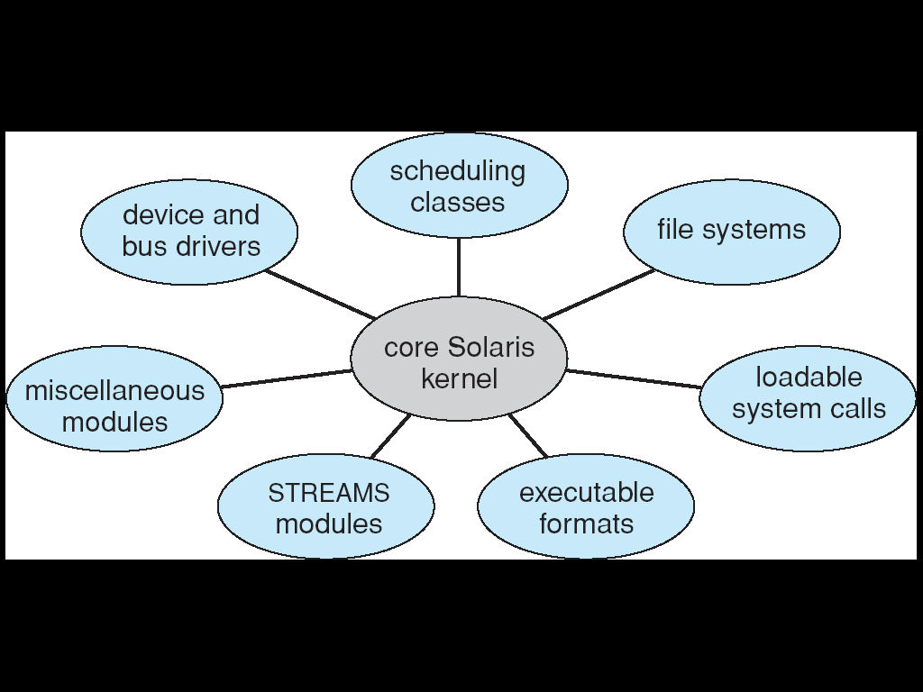
Modules
Many modern operating systems implement loadable kernel modules.
The kernel has a set of core components and dynamically links in additional services via modules, either at boot time or during run time.
common in modern implementations of UNIX such as Solaris, Linux, and Mac OS X, as well as Windows
Uses object-oriented approach
Each core component is separate
Each talks to the others over known interfaces
Each is loadable as needed within the kernel

Slide 51
Modules
resembles a layered system
each kernel section has defined protected interfaces.
more flexible, any module can call any other module.
similar to microkernel approach
the primary module has only core functions and knowledge of how to load and communicate with other modules.
more efficient, modules do not need to invoke message passing in order to communicate.

Slide 52
Hybrid Systems
Most modern operating systems are actually not one pure model
Hybrid combines multiple approaches to address performance, security, usability needs.
Linux and Solaris
Monolithic, the kernel in a single address space，high efficiency
Modular, new functionality can be dynamically added to the kernel
Windows
mostly monolithic
plus microkernel for different subsystem personalities, run as user-mode processes.
Provide support for dynamically loadable kernel modules

Slide 53
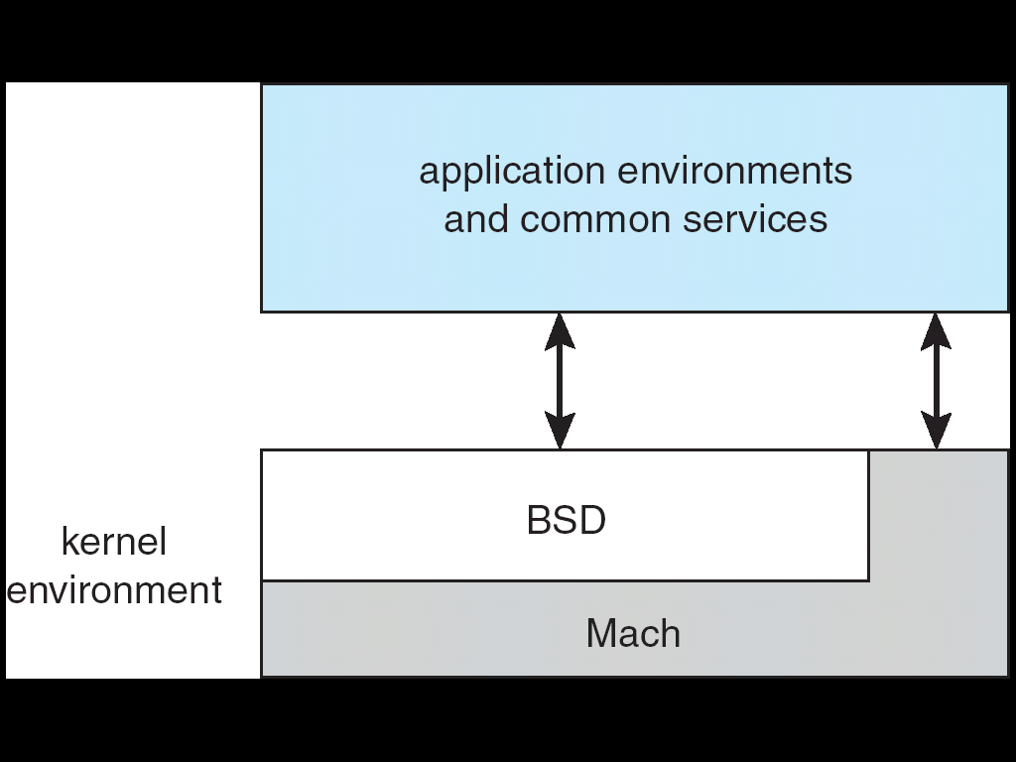
A hybrid structure: Mac OS X (Darwin)
Graphical Interface
BSD CLI,
Networking, file systems,
Implementation of POSIX APIs, including Pthreads
Memory management,
Support for RPC and IPC,
Message passing,
Thread scheduling
I/O kit for development of device drivers and dynamically loadable modules (kernel extensions)

Slide 54
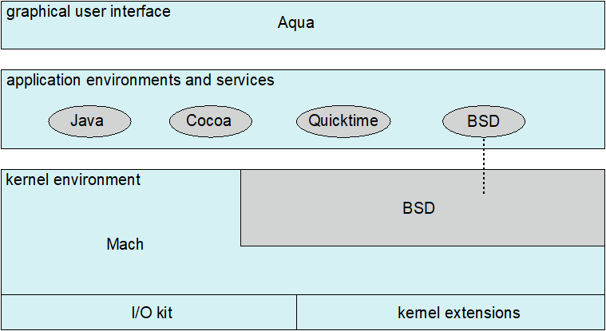
Apple Mac OS X
Hybrid
Layered, microkernel, modules.
layered
Top layers, Aqua UI Cocoa programming environment
Below is kernel environment, consisting of:
Mach microkernel, provides memory management, support for RPCs and IPC facilities, including message passing, and thread scheduling.
BSD UNIX kernel, provides a BSD command-line interface, support for networking and file systems, and an implementation of POSIX APIs, including Pthreads.
I/O kit, for development of device drivers and dynamically loadable modules
kernel extensions， dynamically loadable modules

Slide 55
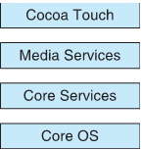
iOS--Apple mobile OS for iPhone, iPad
Structured on Mac OS X, added functionality
Does not run OS X applications natively
runs on different CPU architecture (ARM vs. Intel)
Cocoa Touch, Objective-C API for developing apps run on iOS devices.
Media services layer for graphics, audio, video
Core services provides a variety of features, and support for cloud computing and databases.
Core operating system, based on Mac OS X kernel

Slide 56
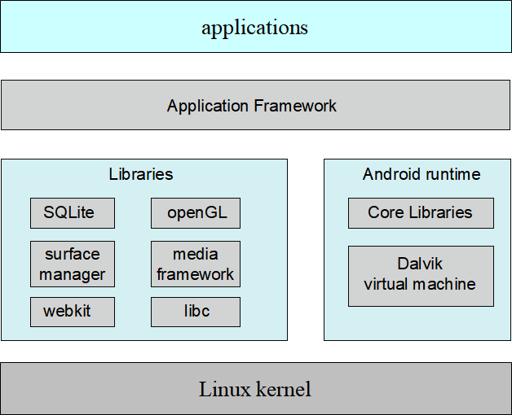
Android
Developed by Open Handset Alliance (开放手机联盟, mostly Google), Open Source
Similar to iOS, a layered stack of software, provides a rich set of frameworks for developing mobile apps.
Android Libs:
database;
web browser;
multimedia;
libc, smaller, for the slower CPUs
Android APIs
&
Dalvik VM
Modified
Process, memory, device-driver,
power management

Slide 57
Android
Based on Linux kernel but modified
Provides process, memory, device-driver management
Adds power management
Runtime environment, includes core set of libraries and Dalvik virtual machine
Apps developed in Java plus Android API
Java class files are compiled to Java bytecode, then translated to executable files, runs in Dalvik VM.
The Dalvik VM, designed for Android, is optimized for mobile devices with limited memory and CPU processing capabilities.
Libraries, include:
webkit, frameworks for web browser
SQLite, database
multimedia
libc, similar to the standard C library, but much smaller, designed for the slower CPUs that characterize mobile devices.
A3: other types OS structure？

Slide 58
2.8 Virtual Machines (VM)
The operating system creates the illusion of multiple processes, each executing on its own processor with its own (virtual) memory.
By CPU scheduling
By virtual memory
The resources of the physical computer are shared to create the virtual machines.
A virtual machine takes the layered approach to its logical conclusion. It treats hardware and the operating system kernel as though they were all hardware.
A virtual machine provides an interface identical to the underlying bare hardware.

Slide 59
Virtual Machines (VM)
Virtualization is a technology that allows operating systems to run as applications within other operating systems.
VMM (virtual machine Manager) provides virtualization services
OS natively compiled for CPU, running guest OSes also natively compiled.
Emulation used when source CPU type different from target type.
e.g. emulation facility “Rosetta”, allowed applications compiled for the IBM CPU to run on the Intel CPU.
When computer language not compiled to native code – Interpretation (e.g. BASIC, Java)

Slide 60
System Models

Slide 61
Advantages/Disadvantages of VM
Virtual machine provides complete protection of system resources.
Each VM is isolated from all other virtual machines. This isolation permits no direct sharing of resources.
A virtual machine system is a perfect vehicle for operating-systems research and development.
System development is done on the virtual machine, so does not disrupt normal system operation.
VMs are increasing in popularity as a means of solving system compatibility problem.

Slide 62
Advantages/Disadvantages of VM
Virtual machine is difficult to implement
due to the effort required to provide an exact duplicate to the underlying machine.
Virtual user mode and virtual monitor mode, run in a physical user mode.
Actions that cause a transfer from user mode to monitor mode on a real machine must also cause a transfer from virtual user mode to virtual monitor mode on a virtual machine.
User process
System call
Set user mode
application
VM
I/O request
Set user mode
Physical
monitor mode

Slide 63
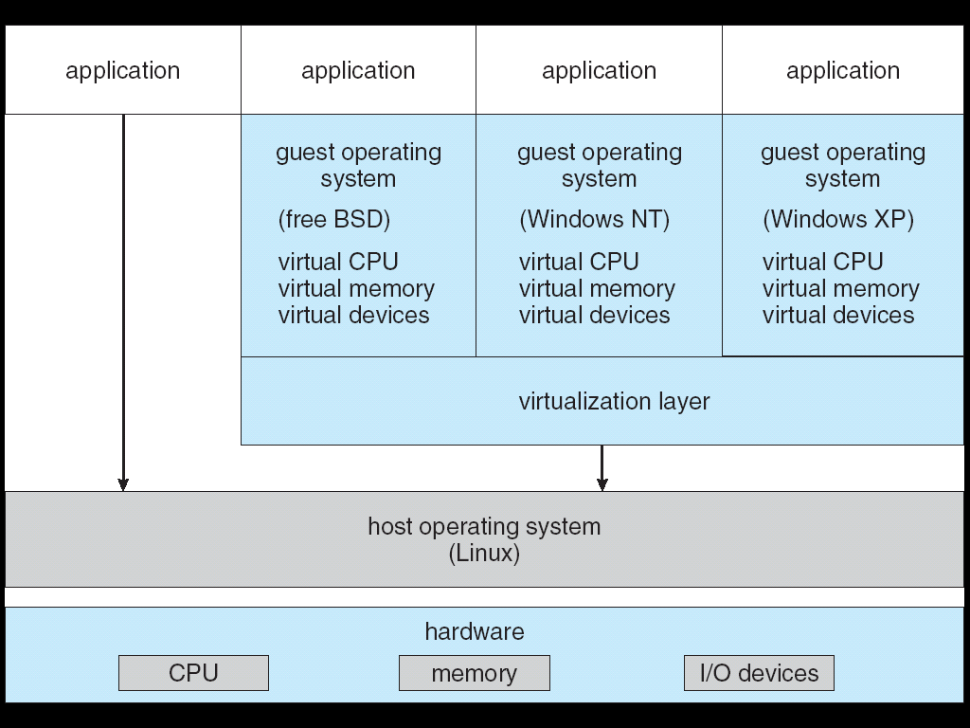
Example: VMware Architecture

Slide 64
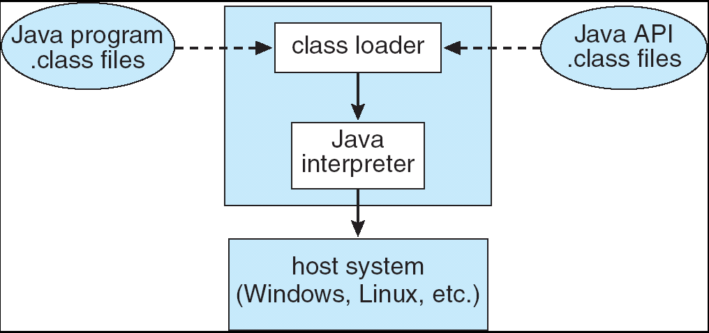
Example: Java Virtual Machine
JVM consists of
class loader
class verifier
Java interpreter
Java interpreter
software module that interprets the bytecodes one at a time
Just-In-Time (JIT) compilers turns the architecture-neutral bytecodes into native machine language for the host computer.
JVM automatically manages memory by performing garbage collection.

Slide 65
2.9 Operating System Generation
Operating systems are designed to run on any of a class of machines; the system must be configured for each specific computer site.
SYSGEN program obtains information concerning the specific configuration of the hardware system.
CPU, memory size, devices, buffer size and number, etc.
System generation methods
To modify a copy of the source code of the OS.
To create tables and select modules from a precompiled library.
To create the appropriate tables to describe the system, the system is completely table driven. Selection occurs at execution time.

Slide 66
2.10 System Boot
Operating system must be made available to hardware so hardware can start it.
Booting – starting a computer by loading the kernel.
Bootstrap program (bootstrap loader)
small piece of code stored in ROM
locates the kernel, loads it into memory, and starts its execution.
two-step process
bootstrap loader
diagnostics, initialize the system
fetches the boot program from boot block into memory to execute.
boot program
loads the entire OS into memory and begin its execution

Slide 67

课后作业及研究性学习
作业：
掌握操作系统提供服务的方式
掌握系统调用实现原理
实验：熟悉实验环境及操作
研究性学习
讨论设计操作系统的不同方法
调研国产操作系统现状，撰写调研报告
A4: 国产OS现状？

Slide 68
A1: UI
操作系统的汉化
More Human-Computer Interface
Speech/Voice
Image/Vision/Graphic
Gesture
Brain-Computer interface, BCI

Slide 69
操作系统的汉化
CCDOS
Chinese Characters Disk Operation System
中国第一台PC长城机汉字操作系统。
电子工业部第六研究所（后中国计算机系统工程公司）研制。
中国大陆最早的汉字操作系统之一，也是20世纪80年代较为流行的中文系统，更是众多DOS中文系统的基础。
在DOS的基础上，对其输入、输出模块进行了汉化。 汉字信息处理要解决的是汉字的输入或输出（显示或打印）。CCDOS对DOS的改造就是对BIOS部分功能扩充，故称CCDOS为CC-BIOS。

Slide 70
操作系统的汉化
2.13 汉字系统（HHBIOS）
吴晓军研制的汉字系统，20世纪80年代到90年代较为流行的中文系统。
运行于DOS环境下
1985年，吴晓军对CCDOS2.10进行了改造，即最初的2.11。
1986年4月，2.13问世。
1986年12月，2.13A问世。2.13 C、…、2.13 F和2.13 H
1991年，2.13 I型晓军汉卡发布；随后2.13 II型汉卡发布（即2.13 K）。
1993年2.13 L发布。

Slide 71
操作系统的汉化
UCDOS
北京希望公司研制的汉字系统，性能优良，版本号发展到UCDOS 7.0
系统装卸灵活方便，可以不重新启动操作系统，可用命令将UCDOS汉字系统从内存中消除，而不破坏MS-DOS或PCDOS的操作系统。
显示与打印字库的安装灵活有效。可以根据系统资源与工作需要，将字库放在不同的存储区，这样可以达到节省主存空间，充分利用机器资源的目的。
系统可以根据需要将显示字库放在扩展内存中，以节省主存空间。还可以方便地将系统中某些部分减掉，以便使更大的程序运行
多种汉字输入方法都能使用单字联想功能；并且可采用窗口提示方式，最有效地提高屏幕的使用面积。

Slide 72
操作系统的汉化
中文之星
Windows外围汉化的杰出代表。
1992年，北京新天地公司发布了业界第一个英文Windows外挂式中文操作系统——中文之星1.1。
2000年6月，中文之星公司正式从原新天地电子信息技术研究所以及方正新天地软件公司脱离，经改组，成立北京中文之星数码科技有限公司。
国外软件中文化速度越来越快、质量越来越高，中文之星的作用？
中文之星智能狂拼，基于CLM（中文语言模型）技术的整句输入法。

Slide 73
Speech/Voice
语音用户界面(VUI)：利用声音信息作为人机交互内容
语音用户界面包括三个关键技术
语音识别：将音频信号转换为符号信息，如语音录入
语音翻译：语音到文本的转换，如讲话口述系统
语音合成：根据文本数据产生语音
Windows 7自带语音识别系统 speech recognition；
Win10：语音助手小娜
苹果：语音助理服务 Siri
语言理解
识别语音，理解代表的含义

Slide 74

Image/Vision/Graphic
图像(Image)识别：
车牌号识别
图像/视觉(Vision)理解：
车辆行为的理解、监控
图形(Graphic)生成、处理
视觉理解：根据视频能够看出图中物体的动作
如图所示
两个人，中间有一提袋，两人相对，似乎是在传递这个提袋;
根据这张画，可以理解出： 左边的人正在给右边的人这个提袋。
识别结果： "GIVE"

Slide 75


Gesture
手语包括双手、面部表情、口型和体势多方面的信息
除了双手表达外，还用面部表情、口型等进行辅助，如果遮挡面部信息，并且预先不知道谈话背景，手语的可懂度只有60%。
要真正实现手语识别，必须包括面部信息，即实现手势、口型、面部表情、体势的多通道信息的融合理解。
手语识别
通过计算机采集设备获得聋哑人的手语数据，采用模式识别算法，结合上下文知识，获知手语含义，进而翻译成语音，传达给不懂手语的正常人，使得正常人可以“听懂手语”。
手语合成技术
正常人通过语音表达自己的意图，计算机将语音翻译为手语并表现出来，向聋哑人传递信息，使得聋哑人能够“看懂”声音 。

Slide 76
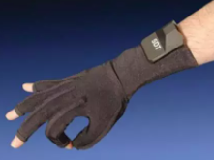

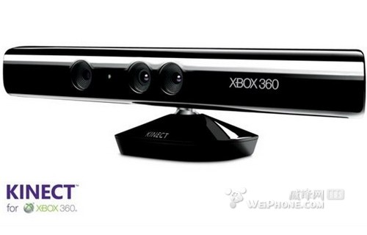
Gesture
识别方法
基于数据手套的识别
利用数据手套和位置跟踪器测量手势在空间运动的轨迹和时序信息。
识别率高，但打手语的人要穿戴复杂的数据手套和位置跟踪器，输入设备比较昂贵。
基于视觉(图像)的手语识别系统
利用摄像头，捕捉手势动作；通过图像理解，理解手势含义。
缺点：将三维立体的手语数据转为平面二维数据时会丢失信息
微软Kinect控制器具备手语识别功能
微软公司为自己的Kinect动作感应游戏控制器申请了一项名为“手势输入”的专利。
应用这项专利之后，Kinect控制器将可读懂人的手语。

Slide 77


Gesture
案例1：MIT开发独特识别算法，实现手势追踪界面
实验者戴上一双莱卡纤维布料的手套，使用廉价的摄像机和一个广角镜头，该软件就能在三维空间探测出实验者的手以及手指的方向和位置，实现对手势的实时追踪。
为了获得手势信息，研究人员需要进行特征测定，以确定手的位置，并分析手指之间的相对位置。
研究人员给手套的不同部位涂上不同的颜色，形成了独特的色块图案，这些色块能详细描述特征信息，这是测出位置和方向的关键。
北邮工作：

Slide 78
脑/神经—机接口
脑-机接口是神经科学和工程技术学科交叉产生的一项具有深远意义的创新性发明。
脑-机接口（Brain-Computer Interface，BCI）
一种大脑和机器之间的通信设备，在大脑与外部设备之间建立一种直接的交流通道。
以计算机为基础的系统，通过实时记录人脑的脑电波并进行分析，在一定程度上解读人的思维，并将其“翻译”成控制命令，传递给输出设备，以执行所需的动作。
实现 “心想事成”
可广泛应用于无人驾驶、工业控制、教育、娱乐、助老/助残设备和医疗领域等。
分类
侵入式BCI
非侵入式BCI

Slide 79

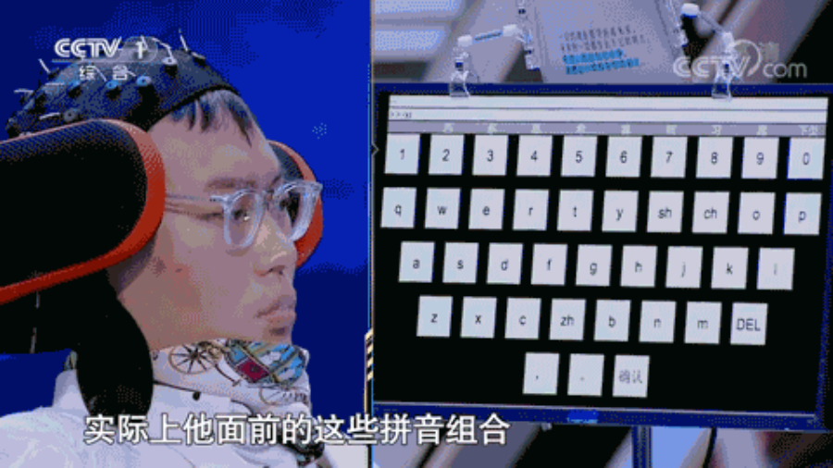
非侵入式BCI
直接从人的头皮表面记录神经信号
获得的神经信号更容易受到噪声的干扰
典型系统：EGG（脑电图）
2019年4月7日，《挑战不可能》节目 渐冻症患者王甲，使用清华大学医学院神经工程团队带来的无创脑机接口打字系统，通过对视觉神经信号的解码完成了打字任务。

Slide 80
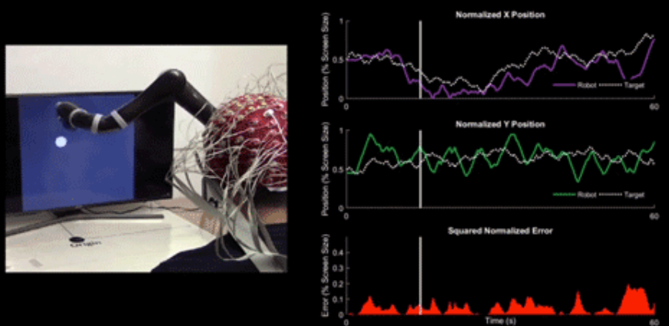

非侵入式BCI
2019年6月19日，卡内基梅隆大学（CMU）生物医学工程系教授贺斌团队与明尼苏达大学合作，开发出了一种可与大脑无创连接的脑机接口，能让人用意念控制机器臂连续、快速运动。
第一款非侵入式的意念控制机械臂，能够连续跟踪随机运动的计算机光标。
北邮工作：

Slide 81
侵入式BCI
主要用于重建特殊感觉（例如视觉）以及瘫痪病人的运动功能。
此类BCI通常直接植入到大脑的灰质，因而所获取的神经信号的质量比较高。
缺点：容易引发免疫反应和愈伤组织（疤），进而导致信号质量的衰退甚至消失。
脑机接口助患者重获视觉
1978年，Dobelle在一位男性盲人Jerry的视觉皮层植入了68个电极的阵列，并成功制造了光幻视（Phosphene）。
该脑机接口系统包括一个采集视频的摄像机，信号处理装置和受驱动的皮层刺激电极。
植入后，病人可以在有限的视野内看到灰度调制的低分辨率、低刷新率点阵图像。
该视觉假体系统是便携式的，且病人可以在不受医师和技师帮助的条件下独立使用。
2000年，Dobeele博士的脑机接口系统成功恢复了一名盲人志愿者有限的导航能力。

Slide 82

侵入式BCI
脑机接口技术助瘫痪男子重获触觉， 入选2020年世界十大科技进展新闻
美国巴泰尔科研中心和俄亥俄州立大学韦克斯纳医学中心的研究团队在《细胞》上发文，他们在患者的运动皮层植入了微型芯片，将大脑电信号转到电脑上控制手臂，使其能够再次抓住和感觉物体，成功利用脑机接口系统帮瘫痪患者恢复了手部触觉，引起了业界轰动。
使用大脑信号来控制假肢的设想，最早由Lloyd M. Nirenberg（劳埃德·M.尼尔伯格）等人于1971年提出。
1973年，加州大学洛杉矶分校的Jacques J.Vidal教授正式发表论文 《Toward Direct Brain-Computer Communication》， 并首次创造了“BCI”术语，并搭建了世界上第一个脑机接口系统。
扩展阅读
脑机接口助患者重获触觉入选2020年世界十大科技进展新闻 (baidu.com)
脑机接口_百度百科 (baidu.com)

Slide 83
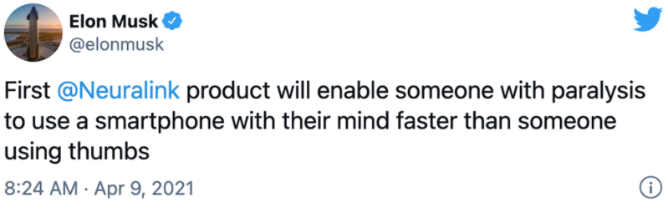
侵入式BCI
2021.4.9，马斯克创办的脑机接口公司Neuralink放出一个3'28" 新视频，展示了一只9岁的恒河猴用意念玩电子乒乓球游戏。
这只猴子的颅骨被植入了一颗芯片，能无线充电，猴子的外表看不出来任何异常，它只需在大脑中想象操作杆该怎么移动——“全凭意念”玩乒乓游戏。
马斯克为此连发6条推文，说Neuralink的第一款产品，将让瘫痪患者用意念操作智能手机，而且速度将会比手指还要快。

Slide 84
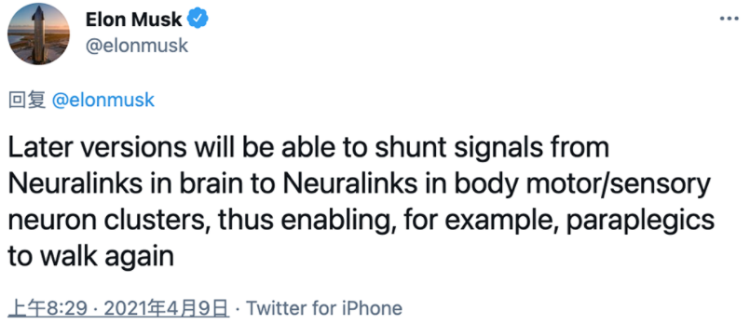
侵入式BCI
后续版本还能将信号从大脑中的神经连接分流到身体运动/感觉神经元簇中的神经连接，使得截瘫患者能再次行走。
目前这一最新研究成果运用的，是最新Neuralink设备LINK V0.9 。

Slide 85
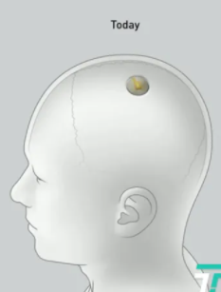
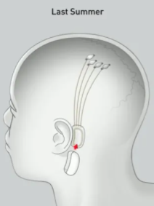
侵入式BCI
LINK V0.9脑机接口技术
传感器设备Link V0.9，直径23mm，厚度8mm，一个硬币大小，植入人们颅顶部位后，与人脑连接。
无线传输脑电波数据，让脑-机之间获得实时传输能力。
感应充电，只需晚上充电，白天能用一整天，甚至可以无线充电。
通过一台小手术机器人，像微创眼科手术一样安全无痛地在脑袋上穿孔，向大脑内快速植入芯片，实时读取脑电波，无线对外传输，并可以用手机控制。
和2020年马斯克发明的“脑后插管”植入N1芯片相比，设备进一步大大简化了：N1芯片需要通过数据线，才能把芯片读取的大脑信号传送出来，所以在耳朵旁边，还挂个设备。

Slide 86
脑机接口金字塔
第一层，修复
通过心念操纵机器，让机器替代人类身体的一些机能，修复残障人士的生理缺陷。
2014年巴西世界杯开幕式，瘫痪的青年利亚诺·平托就是穿了这样庞大、笨重的外骨骼，通过脑机接口踢出了当年世界杯的第一球。
第二层，改善
通过脑机接口，改善大脑运行，让使用者时刻保持精神抖擞、注意力集中、思维敏捷，能够高效清醒高效地去做一件事情。
美国旧金山，Smart Cap公司，把脑电图做成了棒球帽。这个产品可以用来缓解卡车司机的疲劳驾驶，提高注意力，减少交通危险。
2014年，美国ABM公司，通过脑电图脑机接口训练实验者，使新手学习速度比原先提升了2.3倍。

Slide 87

脑机接口金字塔
第三层，增强
通过脑机接口，让使用者短时间内拥有大量的知识和技能，获得一般人类无法拥有的超能力。
记忆移植。美国科学家已经发现大脑海马体的记忆密码，开始尝试用芯片备份记忆，然后把芯片植入另一个大脑，实现记忆移植。这个实验已经在猴子身上取得成功。
实现人类意识和记忆在计算机世界的永生。
第四层，沟通
有了脑机接口，人类不用语言，仅靠脑电信号就可以彼此沟通，实现“无损”的大脑信息传输。
彻底的、100%的、毫无信息 扭曲的“心领神会”。
Facebook的科学家正在研究。 他们想让人们思考一些东西的同时，把想法传到他人的皮肤上，让人们通过皮肤“听到”声音，进而实现沟通。

Slide 88
A2: openEuler系统调用实现
系统调用基本概念
解决办法
openEuler 系统调用的实现
1. 库函数调用
2. 异常处理
3. 系统调用服务函数的查找
4. 服务函数的执行
5. 异常返回

Slide 89
系统调用基本概念
操作系统通过系统调用向进程提供服务接口，限制进程直接进行硬件资源操作。
为解决不同进程之间共享硬件资源的问题，采取的基本思路是：
操作系统保持对CPU的控制权，并负责硬件资源的管理；
限制进程直接操作硬件资源；
在进程希望执行受限的操作时，进程需要将CPU控制权移交给操作系统，由操作系统执行进程所请求的服务。
关键挑战：
如何限制进程所能进行的操作？
操作系统如何为进程服务？

Slide 90
解决办法
基于处理器硬件和操作系统软件的协作来解决这两个挑战。
在硬件方面， CPU模式分为内核模式与用户模式，并用寄存器的特定字段标识当前模式。
CPU在内核模式执行的是内核态代码，在用户模式执行的是用户态代码。
在内核态运行的代码，对资源的操作不受限制，能够执行所有的指令、操作所有的寄存器和内存空间、发出I/O请求；
在用户态运行的代码，对资源的操作受到限制，不能执行可能对其他用户进程或内核造成威胁的指令，不能进行磁盘I/O，而且也只能访问部分内存空间。

Slide 91
解决办法
在软件方面：
将受限的操作设计成内核功能，并以系统调用的形式暴露给用户进程。
用户通过暴露的系统调用接口来使用操作系统的关键功能。
用户进程在执行的过程中调用了系统调用接口，将触发异常，导致CPU陷入内核模式，同时硬件将CPU的控制权移交给预先设定的异常处理程序。
异常处理程序进而将该系统调用派发给内核中该系统调用的处理程序。
当操作系统完成用户进程所请求的服务，再通过陷阱返回指令使CPU回到用户模式，并将CPU控制权移交给用户进程。

Slide 92
openEuler 系统调用的实现
系统调用sys_getpid()可返回当前进程的PID。
进程的PID存储在PCB中，而PCB是不允许用户进程任意访问或修改的。
若该进程修改其运行时间，在时间片轮转调度下，该进程就可以一直获得CPU的使用权。
为了满足用户程序获取其PID的需求，同时又限制其对PCB的访问，操作系统通过服务函数sys_getpid()获得当前进程的PID并返回给应用程序。

Slide 93
系统调用实现的关键步骤
包括：
库函数调用、异常处理、 系统调用服务函数的查找、服务函数的执行、 和异常返回

Slide 94
1. 库函数调用
在用户态下，用户进程需配置参数寄存器并调用指令SVC去发起系统调用。
glibc函数库对系统调用进行了封装，屏蔽了指令SVC与参数传递等细节，仅向用户进程提供一个库函数。
编程人员只需调用该库函数就可以使用openEuler 提供的系统调用服务。
getpid() 其需要完成两项任务： 参数填充和触发系统调用。
库函数将高级语言传递的参数通过汇编语言赋值给特定的寄存器，向内核传递系统调用参数与系统调用号。
openEuler中，待传递的参数保存在寄存器X0~X6中，系统调用号保存在寄存器X8中。
1.int main() {
2.int pid = getpid();
3.printf("pid = %d/n",pid);
4.return 0;
5.};

Slide 95
2. 异常处理
用户进程执行指令SVC时就会产生一个异常。CPU会先对该异常进行初步处理，自动执行以下操作：
将PSTATE相关寄存器的数据作为字段内容一起存入寄存器SPSR_EL1中。
将返回地址保存到寄存器ELR_EL1中，使得当该进程从异常处理程序返回时可以从它离开的地方继续执行。对系统调用而言，保存的是系统调用发生时即将执行的下一条指令的地址。
将异常屏蔽寄存器的4个掩码位DAIF置为1，即关中断。
如果是同步异常，将生成异常的原因保存到寄存器ESR_EL1中。
将寄存器组PSTATE中寄存器CurrentEL的字段EL置为1，即把异常级别提升到EL1。

Slide 96
异常处理
操作系统需执行异常处理程序来进一步处理该异常。
内核维护着异常向量表。
内核根据异常类型号从异常向量表中快速找到异常处理程序的入口。
在MMU初始化时，操作系统将该表的首地址存到向量基址寄存器VBAR_EL1中，之后CPU直接通过该寄存器获取异常向量表首地址。
CPU会自动读取寄存器VBAR_EL1以获取异常向量表基址，把此基地址加上异常类型对应的偏移量，即可在异常向量表中找到相应的异常处理函数入口地址，随后可跳转进入此处理函数。

Slide 97
同步异常处理
同步异常处理函数可执行三个步骤：
① CPU状态保存；
调用CPU状态保存函数kernel_entry()
异常处理结束并返回用户态后，能从中断发生的地方继续 执行该进程。
② 触发异常原因判断；
openEuler中由SVC引发的同步异常被编号为ESR_ELx_EC_SVC64=0x15。
异常发生时，硬件自动把异常状态信息（如异常级别、被捕获指令长度等）保存在寄存器ESR_EL1中。
通过将ESR_EL1中所存的状态信息与各编号比较，操作系统可以判断出当前产生的同步异常是由SVC引发的，并跳转至函数el0_svc()执行，

Slide 98
同步异常处理
同步异常处理函数可执行三个步骤：
③ 调用相应异常处理函数及传递参数。
函数el0_svc()是系统调用异常处理的开始。
OS先跳转到一个C语言函数去做一些预备工作。
检查系统调用号是否合法、是否开中断等
将系统调用参数和系统调用号传递给C语言函数el0_svc_handler()。
内存空间的传递利用内存首地址进行，结构体pt_regs所在内存的首地址保存在堆栈指针寄存器SP中
通过执行“mov x0, sp”指令可将堆栈指针读到寄存器X0中，作为参数传递给函数el0_svc_handle()。
函数el0_svc_handle()将该指针指向的内存解释为pe_regs结构
可通过结构体变量regs引用栈内保存的相关寄存器内容，从而获得系统调用号等参数。
函数el0_svc_handler()再通过所给的参数完成查找、执行指定的系统调用的逻辑。

Slide 99
3. 系统调用服务函数的查找
openEuler内核中定义的服务函数与系统调用号一一对应。
操作系统在用户进程执行系统调用时，通过寄存器向内核传递系统调用号和参数，并使用系统调用号来找到对应的服务函数。
内核用一个数据结构来保存系统调用号和与服务函数的对应关系，这个数据结构就是系统调用表(syscall table)。
系统调用表的本质是一个全局数组，数组元素是指向处理函数的指针。
内核以系统调用号作为索引，可得到相应处理函数的地址。
系统调用getpid()对应的内核中的服务函数为sys_getpid()。

Slide 100
服务函数的调用过程
在函数invoke_syscall()中
首先读取结构体变量regs中的regs[8]，获取系统调用号并将其赋值给scno；
然后使用scno作为系统调用表下标，得到该系统调用号所对应的服务函数的地址；
最后将保存系统调用参数的结构体变量regs传递给该服务函数。
服务函数将根据需求读取regs[0]~regs[6]。

Slide 101
4. 服务函数的执行
根据系统调用表找到对应的服务函数后，内核将执行该函数来为用户进程服务。
对于获得进程号这个功能，就是去执行函数sys_getpid()。
openEuler内核使用宏current来代表指向当前进程结构体task_struct的指针。
服务函数sys_getpid()可根据宏current来获得所求PID，并存入寄存器X0中作为返回值。

Slide 102
5. 异常返回
在用户进程返回用户态时，需要做的是恢复CPU状态。
状态寄存器PSTATE、程序计数器PC以及堆栈指针寄存器SP_EL0等都将被恢复。
在通过寄存器X21、X22、X23完成寄存器ELR_EL1、SPSR_EL1和SP_EL0数据的恢复后，将所有的通用寄存器恢复，最后将寄存器LR的数据恢复。
将先前压入的pt_regs结构栈帧中的数据依次恢复。
在完成所有的数据恢复工作后，就执行指令ERET以返回到用户态。
在返回过程中，CPU自动使用寄存器SPSR_EL1保存的值来恢复状态寄存器PSTATE，使用寄存器ELR_EL1保存的返回地址恢复程序计数器PC。

Slide 103
A3: other types OS structure
LibOS (Library Operating System)
Exokernel
Multi-Core, Many-Core
Splitkernel

Slide 104
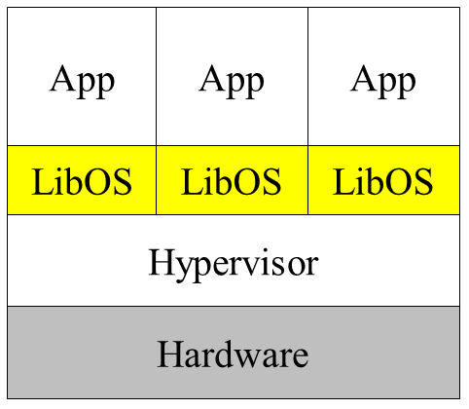
LibOS (Library Operating System)
在云计算平台中，基于应用程序的需求来定制操作系统内核，以最“精简”的操作系统来支撑特定应用程序的运行。
将原本属于操作系统内核的功能以库的形式提供给用户程序。
将底层硬件资源暴露给应用程序，使得应用程序能够直接控制和调配底层硬件资源。
1990's，提出，难以支持种类繁杂的设备，发展受到限制。
虚拟化技术，下一代云计算模式 （如 serverless）兴起，LibOS成为下一代云平台软件部署的主要解决方案。
LibOS体积小，启动快；
在一个虚拟机中部署单个应用，与LibOS使用 单地址空间部署单个应用的特点特别契合。

Slide 105
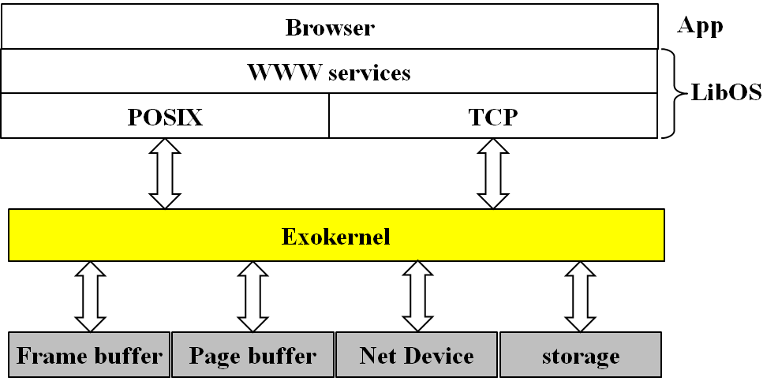
Exokernel
应用程序需求多样性增加，内核提供的接口的固定性，使其成为应用程序提升性能、增强灵活性和拓展性的瓶颈。
外核基本思想：专注于物理资源的隔离（保护）与复用。 不提供传统操作系统中的进程、虚拟内存等抽象。
一个非常小的内核负责保护系统资源，硬件资源的管理职责委托给应用程序。
在保证资源安全的前提下， 减少对应用程序的限制， 充分满足应用程序对硬件 资源的不同需求。
Aegis，MIT

Slide 106
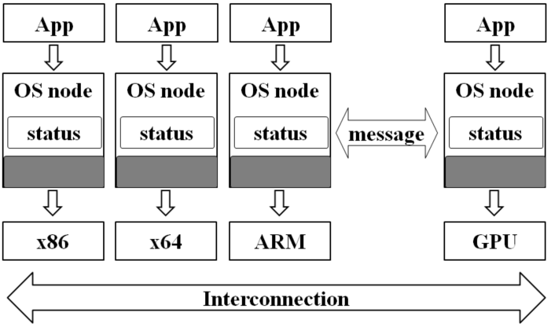
Multi-Core, Many-Core
在多内核操作系统中，机器被视为拥有多个独立CPU核的网络，操作系统被构建为一个分布式系统；
一个CPU核对应一个操作系统内核；
多个内核并行运行，但不共享内存，提供消息进行通信，减少资源共享带来的冲突。
设计指导原则
明确内核之间的通信方式
使操作系统结构与硬件无关
每个内核保存一份状态，而不是共享一个状态。
操作系统以节点的形式存在于每一个核上。
每个操作系统节点的实现与硬件体系结构相关，以灵活地支持硬件异构。
各个操作系统节点之间通过异步消息进行通信。

Slide 107

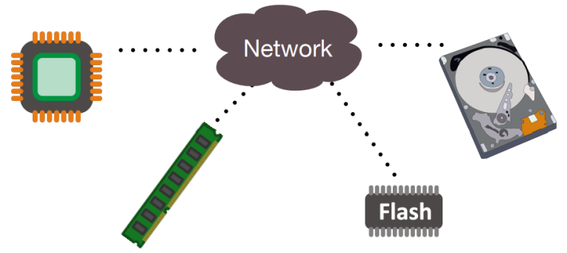
Splitkernel
Existing data centers are organized by servers
resource utilization, low
Heterogeneity, poor
Hardware elasticity, weak
fault tolerance, poor
A discrete data center architecture is proposed
Hardware resource disaggregation: breaking monolithic servers into network-attached, independent hardware components.
Each component has its own controller to manage its own hardware.
Data center is built based on components.

Slide 108
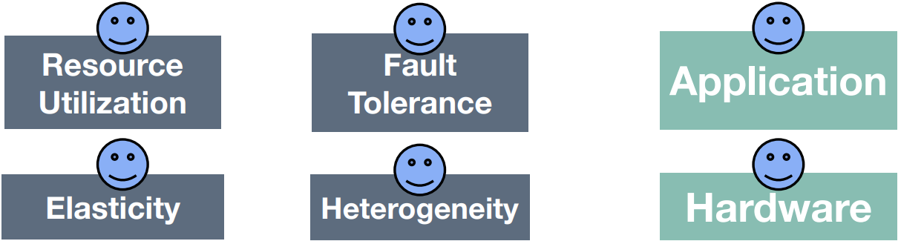
Splitkernel
Benefits
No operating system supports this kind of hardware architecture.
LegoOS: A Disseminated, Distributed OS for Hardware Resource Disaggregation (Yizhou Shan, Yutong Huang, Yilun Chen, and Yiying Zhang, Purdue University)
Split OS functions into monitors
Run each monitor at h/w device
Network messaging across non-coherent components
Distributed resource mgmt. and failure handling

Slide 109
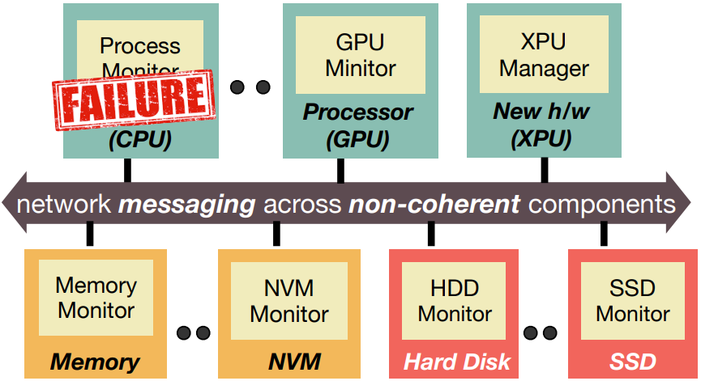
Splitkernel
Hardware resource disaggregation is promising for future datacenters.
The splitkernel architecture and LegoOS demonstrate the feasibility of resource disaggregation.
Great potentials, but many unsolved challenges.

Slide 110
A4: 国产操作系统调研
2014年4月8日起，微软停止了对Windows XP SP3提供服务支持，引起了社会和广大用户的广泛关注和对信息安全的担忧。
2020年对Windows7服务支持的终止再一次推动了国产系统的发展。
国内现状
Windows系统占主导地位。
国产Linux操作系统，在易用性等方面基本具备windows替代能力，但还存在生态环境差等各种问题。
鸡生蛋和蛋生鸡的关系，操作系统 <= => 应用
现实意义
操作系统关系到国家的信息安全。
棱镜事件的主角斯诺登透露的资料显示，微软公司曾与美国政府合作，帮助美国国家安全局，获得互联网上的加密文件数据。
俄罗斯、德国等国家已经推行，在政府部门的电脑中，采用本国的操作系统软件。

Slide 111
国产OS调研
调查国产OS现状，撰写调研报告：
概述国产OS的现状、主要产品，共同特点；
简述Harmony OS的基本情况、特点、应用场景；
简述openEuler的基本情况、特点、应用场景；
简述麒麟操作系统的基本情况、特点、应用场景；
简述UOS的基本情况、特点、应用场景；
简述AlioS的基本情况、特点、应用场景；
国产操作系统的发展将面临哪些挑战？有哪些机遇？
列出主要参考文献
注意事项及要求
用自己的语言组织
写作规范，引用要标明来源
提交电子版，正文内容控制在4页A4左右，最多6页

